Slide 1

Computer Networks
Application Layer – The Email
Lecture # 04

Slide 2
Network Applications
Some important network applications are:
The Web – HTTP
file transfer - FTP
electronic mail – SMTP, POP
directory service - DNS
P2P applications – Distributed file sharing and lookup service

Slide 3
Application Layer- Services & Ports
DNS (Domain Name System)
Resolves Internet names (URLs) to IP Addresses, port 53
Telnet, SSH (Terminal emulation, Secure shell)
access to servers and network devices, port 23, 22
SMTP (Simple Mail Transfer Protocol)
Transfer of mail messages and attachments (outgoing), port 25
POP3, POP3S (Post Office Protocol)
Transfer of mail messages and attachments (incoming), port 110, 995
IMAP
Internet Message Access Protocol, port 143
DHCP (Dynamic Host Configuration Protocol)
Assigns IP Addresses (IP, subnetmask) and other parameters (DNS, Gateway, …) to hosts, port 67, 68
HTTP(s) (Hypertext Transfer Protocol)
Transfer files that make up web pages, port 80, 443
FTP(S) ((Secure) File Transfer Protocol)
Interactive file transfer between systems, port control:21,data:21 and 3713, data:989,990

Slide 4
The Electronic Mail
One of the Internet’s most important and utilized applications.
E-mail is an asynchronous communication medium—people send and read messages when it is convenient for them, without having to coordinate with other people’s schedules.
In contrast with postal mail, electronic mail is fast, easy to distribute, and inexpensive.
Modern e-mail has many powerful features, including messages with attachments, hyperlinks, HTML-formatted text, and embedded photos.

Slide 5
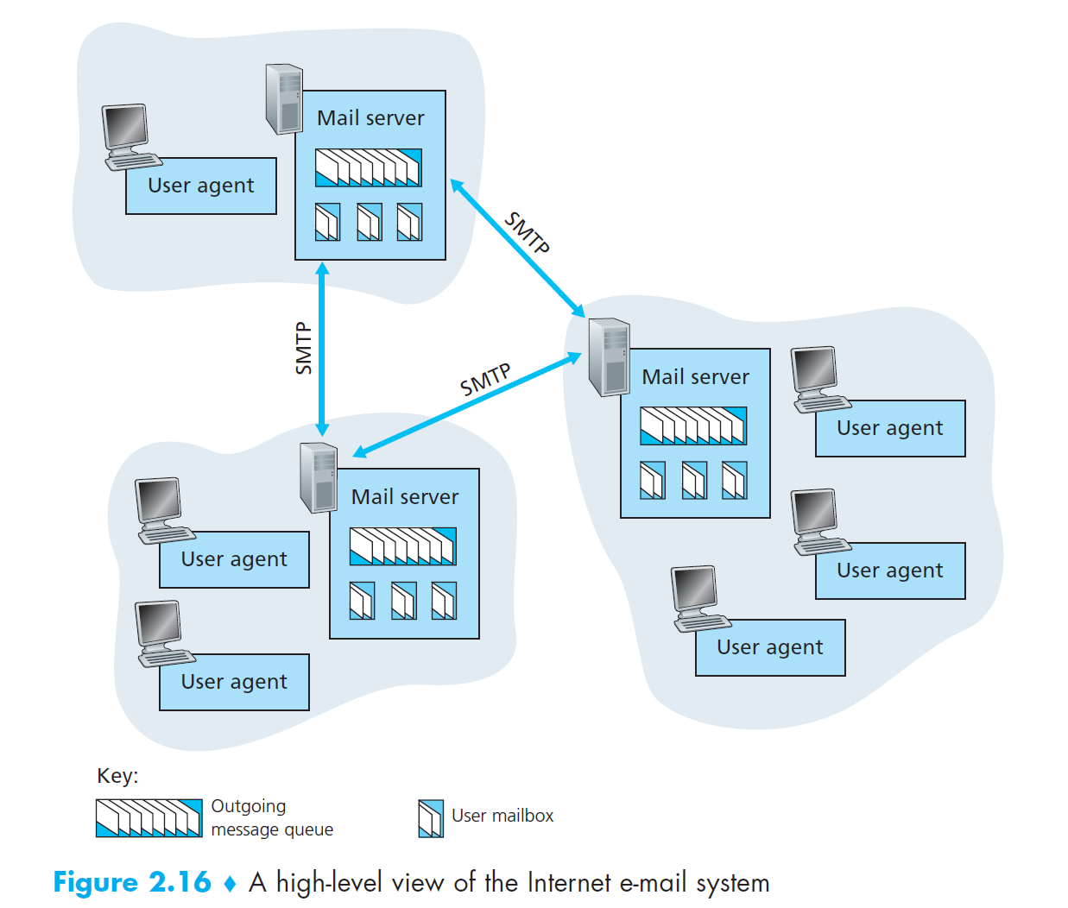
Notes:
User agents allow users to read, reply to, forward, save, and compose messages.
Microsoft Outlook and Apple Mail are examples of user agents for e-mail.
When Alice is finished composing her message, her user agent sends the message to
her mail server, where the message is placed in the mail server’s outgoing message
queue. When Bob wants to read a message, his user agent retrieves the message
from his mailbox in his mail server.
Mail servers form the core of the e-mail infrastructure. Each recipient, such as
Bob, has a mailbox located in one of the mail servers. Bob’s mailbox manages and
maintains the messages that have been sent to him. A typical message starts its journey
in the sender’s user agent, travels to the sender’s mail server, and
travels to the recipient’s mail server, where it is deposited in the recipient’s mailbox. When Bob wants to access the messages in his mailbox, the mail server
containing his mailbox authenticates Bob (with usernames and passwords). Alice’s
mail server must also deal with failures in Bob’s mail server. If Alice’s server cannot
deliver mail to Bob’s server, Alice’s server holds the message in a message
queue and attempts to transfer the message later. Reattempts are often done every
30 minutes or so; if there is no success after several days, the server removes the
message and notifies the sender (Alice) with an e-mail message.

Slide 6
User Agents:
Allow users to read, reply to, forward, save, and compose messages.
Retrieves the message from the mailbox in the mail server.
Microsoft Outlook, Gmail and Apple Mail are examples of user agents for e-mail.
Mail Servers:
Keep messages stored
Resend(every 30 mins or so) messages if needed.
Maintain a mailbox for each user.
Authenticates the end users
SMTP:
principal application-layer protocol for Internet electronic mail.
Both client and server sides.
Notes:
SMTP is the principal application-layer protocol for Internet electronic mail. It
uses the reliable data transfer service of TCP to transfer mail from the sender’s mail
server to the recipient’s mail server. As with most application-layer protocols,
SMTP has two sides: a client side, which executes on the sender’s mail server, and a
server side, which executes on the recipient’s mail server. Both the client and server
sides of SMTP run on every mail server. When a mail server sends mail to other
mail servers, it acts as an SMTP client. When a mail server receives mail from other
mail servers, it acts as an SMTP server.

Slide 7
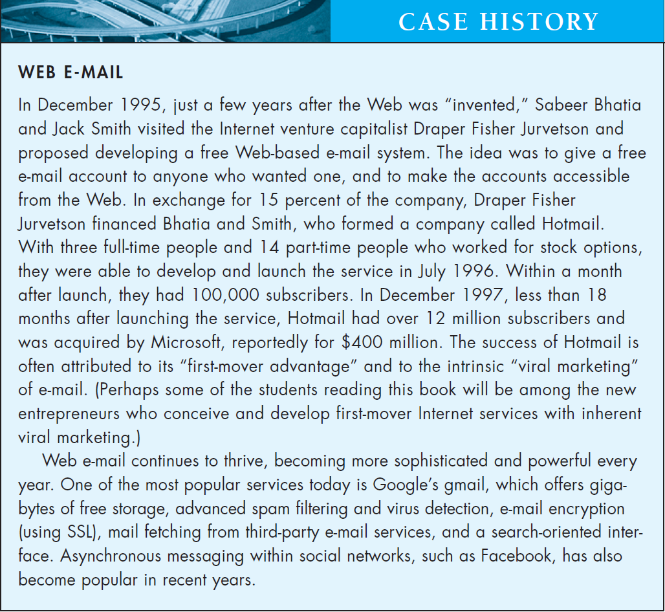

Slide 8
Email Protocol
Email is a store-and-forward method of sending, storing, and retrieving electronic messages.
Email messages are stored in databases on mail servers.
Email clients communicate with mail servers to send and receive email.
Mail servers communicate with other mail servers to transport messages from one domain to another.
Email clients do not communicate directly when sending email.
Email relies on three separate protocols for operation: SMTP (sending),POP (retrieving), IMAP (retrieving).

Slide 9
The SMTP Protocol
Simple Mail Transfer Protocol

Slide 10
SMTP
defined in RFC 5321.
SMTP transfers messages from senders’ mail servers to the recipients’ mail servers.
it restricts the body (not just the headers) of all mail messages to simple 7-bit ASCII.
Uses persistent connection
Notes:
SMTP transfers messages from senders’ mail servers to the recipients’
mail servers. SMTP is much older than HTTP. (The original SMTP RFC
dates back to 1982, and SMTP was around long before that.)
it restricts the body (not just the headers) of all mail messages to
simple 7-bit ASCII. This restriction made sense in the early 1980s when transmission
capacity was scarce and no one was e-mailing large attachments or large
image, audio, or video files. But today, in the multimedia era, the 7-bit ASCII
restriction is a bit of a pain—it requires binary multimedia data to be encoded to
ASCII before being sent over SMTP; and it requires the corresponding ASCII
message to be decoded back to binary after SMTP transport. Recall from Section
2.2 that HTTP does not require multimedia data to be ASCII encoded before
transfer.

Slide 11
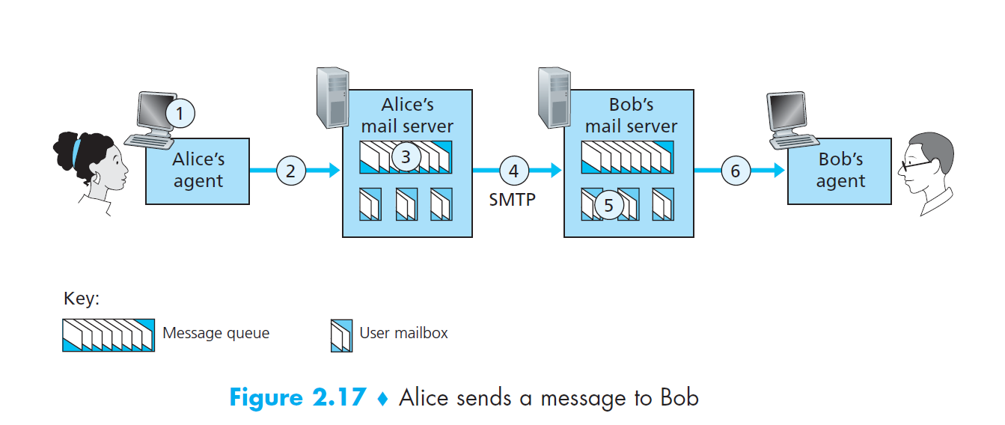

Slide 12
Alice invokes her user agent for e-mail, provides Bob’s e-mail address (for example, bob@someschool.edu), composes a message, and instructs the user agent to send the message.
Alice’s user agent sends the message to her mail server, where it is placed in a message queue.
The client side of SMTP, running on Alice’s mail server, sees the message in the message queue. It opens a TCP connection to an SMTP server, running on Bob’s mail server.
After some initial SMTP handshaking, the SMTP client sends Alice’s message into the TCP connection.
At Bob’s mail server, the server side of SMTP receives the message. Bob’s mail server then places the message in Bob’s mailbox.
Bob invokes his user agent to read the message at his convenience.
Note: SMTP does not normally use intermediate mail servers for sending mail, even when the two mail servers are located at opposite ends of the world.
Notes:
SMTP does not normally use intermediate mail
servers for sending mail, even when the two mail servers are located at opposite
ends of the world. If Alice’s server is in Hong Kong and Bob’s server is in St. Louis,
the TCP connection is a direct connection between the Hong Kong and St. Louis
servers. In particular, if Bob’s mail server is down, the message remains in Alice’s
mail server and waits for a new attempt—the message does not get placed in some
intermediate mail server.

Slide 13
client SMTP (running on the sending mail server host) has TCP establish a connection to port 25 at the server SMTP (running on the receiving mail server host).
Once this connection is established, the server and client perform some application-layer handshaking.
During handshaking, the SMTP client indicates the e-mail address of the sender (the person who generated the message) and the e-mail address of the recipient.
Once the SMTP client and server have introduced themselves to each other, the client sends the message.
SMTP can count on the reliable data transfer service of TCP to get the message to the server without errors.
The client then repeats this process over the same TCP connection if it has other messages to send to the server; otherwise, it instructs TCP to close the connection.
Notes:
Once this connection
is established, the server and client perform some application-layer
handshaking—just as humans often introduce themselves before transferring
information from one to another, SMTP clients and servers introduce themselves
before transferring information.

Slide 14
S: 220 hamburger.edu
C: HELO crepes.fr
S: 250 Hello crepes.fr, pleased to meet you
C: MAIL FROM: <alice@crepes.fr>
S: 250 alice@crepes.fr ... Sender ok
C: RCPT TO: <bob@hamburger.edu>
S: 250 bob@hamburger.edu ... Recipient ok
C: DATA
S: 354 Enter mail, end with “.” on a line by itself
C: Do you like ketchup?
C: How about pickles?
C: .
S: 250 Message accepted for delivery
C: QUIT
S: 221 hamburger.edu closing connection

Slide 15
SMTP Operation
SMTP message formats require a message header and body.
The body can contain any amount of text.
The header must have a properly formatted recipient email address and a sender address.
An SMTP client sends an email by connecting to a SMTP server on port 25.
The server receives the message and stores it message in a local mailbox or relays the message to another mail server.
Users use email clients to retrieve messages stored on the server.
IMAP and POP are two protocols commonly used by email clients to retrieve messages.

Slide 16

Reading Assignment
Compare HTTP and SMTP
Discuss MIME and S/MIME protocols

Slide 17
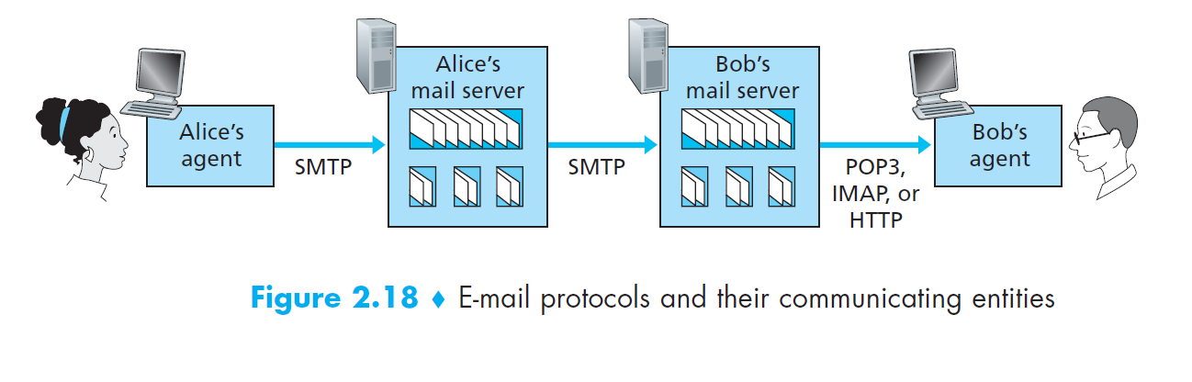
Mail Access Protocols

Slide 18
Email Access Protocols
There are currently a number of popular mail access protocols, including
Post Office Protocol—Version 3 (POP3),
Internet Mail Access Protocol (IMAP), and
HTTP.

Slide 19
POP3 Protocol
Messages are downloaded from the server to the client.
The server listens on port 110 TCP for client requests.
Email clients direct their POP requests to mail servers on port TCP 110.
The POP client and server exchange commands and responses until the connection is closed or aborted.
POP allows for email messages to be downloaded to the client’s device (computer or phone) and removed from the server.
There is no centralized location where email messages are kept.
A downloaded message resides on the device that triggered the download.

Slide 20
POP3 is an extremely simple mail access protocol.
It is defined in [RFC 1939]
Because the protocol is so simple, its functionality is rather limited.
POP3 begins when the user agent (the client) opens a TCP connection to the mail server (the server) on port 110.
With the TCP connection established, POP3 progresses through three phases: authorization, transaction, and update.
During the first phase, authorization, the user agent sends a username and a password (in the clear) to authenticate the user.
During the second phase, transaction, the user agent retrieves messages; also during this phase, the user agent can mark messages for deletion, remove deletion marks, and obtain mail statistics.
The third phase, update, occurs after the client has issued the quit command, ending the POP3 session; at this time, the mail server deletes the messages that were marked for deletion.

Slide 21
Client server communication in POP3
In a POP3 transaction, the user agent issues commands, and the server responds to each command with a reply.
There are two possible responses:
+OK (sometimes followed by server-to-client data), used by the server to indicate that the previous command was fine;
and -ERR, used by the server to indicate that something was wrong with the previous command.

Slide 22
Authentication
The authorization phase has two principal commands: user <username> and pass <password>.
telnet mailServer 110
+OK POP3 server ready
user bob
+OK
pass hungry
+OK user successfully logged on
If you misspell a command, the POP3 server will reply with an -ERR message.
Notes:
Telnet is an application protocol used on the Internet or local area network to provide a bidirectional interactive text-oriented communication facility using a virtual terminal connection.

Slide 23
Transaction
A user agent using POP3 can often be configured (by the user) to “download and delete” or to “download and keep.”
The sequence of commands issued by a POP3 user agent depends on which of these two modes the user agent is operating in.
In the download-and-delete mode, the user agent will issue the list, retr, and dele commands.

Slide 24
suppose the user has two messages in his or her mailbox. In the dialogue below, C: (standing for client) is the user agent and S: (standing for server) is the mail server.
The transaction will look something like:
C: list
S: 1 498
S: 2 912
S: .
C: retr 1
S: (blah blah ...
S: .................
S: ..........blah)
S: .
C: dele 1
C: retr 2
S: (blah blah ...
S: .................
S: ..........blah)
S: .
C: dele 2
C: quit
S: +OK POP3 server signing off
Notes:
the POP3 server does not carry state
information across POP3 sessions.

Slide 25
IMAP
Internet Message Access Ptotocol, defined in [RFC 3501]
Defined to handle the need of multiple access to the mail server.
An IMAP server will associate each message with a folder.
When a message first arrives at the server, it is associated with the recipient’s INBOX folder. The recipient can then move the message into a new, user-created folder, read the message, delete the message, and so on.
The IMAP protocol provides commands to allow users to create folders and move messages from one folder to another. IMAP also provides commands that allow users to search remote folders for messages matching specific criteria.
IMAP server maintains user state information across IMAP sessions. Another important feature of IMAP is that it has commands that permit a user agent to obtain components of messages.
Notes:
An IMAP server will associate each message with a folder; when a message first
arrives at the server, it is associated with the recipient’s INBOX folder. The recipient
can then move the message into a new, user-created folder, read the message, delete
the message, and so on. The IMAP protocol provides commands to allow users to
create folders and move messages from one folder to another. IMAP also provides
commands that allow users to search remote folders for messages matching specific
criteria. Note that, unlike POP3, an IMAP server maintains user state information
across IMAP sessions—for example, the names of the folders and which messages
are associated with which folders.
Another important feature of IMAP is that it has commands that permit a user
agent to obtain components of messages. For example, a user agent can obtain just
the message header of a message or just one part of a multipart MIME message.
This feature is useful when there is a low-bandwidth connection (for example, a
slow-speed modem link) between the user agent and its mail server. With a lowbandwidth
connection, the user may not want to download all of the messages in
its mailbox, particularly avoiding long messages that might contain, for example,
an audio or video clip.

Slide 26
IMAP Operation
IMAP is another protocol used to retrieve email messages.
Allows for messages to be displayed to the user rather than downloaded.
The original messages reside on the server until manually deleted by the user.
Users view copies of the messages in their email client software.
Users can create a folder hierarchy on the server to organize and store mail.
That file structure is displayed on the email client.
When a user decides to delete a message, the server synchronizes that action and deletes the message from the server.
Notes:
Internet Message Access Protocol (IMAP) means that all of your email is saved on your Internet Service Provider's servers. If you are using IMAP, you can run an email program at home and an email program at work and both programs will access the same set up messages and folders.
By default, the IMAP protocol works on two ports: Port 143 – this is the default IMAP non-encrypted port; Port 993 – this is the port you need to use if you want to connect using IMAP securely.

Slide 27
Web-Based Email
More and more users today are sending and accessing their e-mail through their Web browsers.
With this service, the user agent is an ordinary Web browser, and the user communicates with its remote mailbox via HTTP.
When a recipient, such as Bob, wants to access a message in his mailbox, the e-mail message is sent from Bob’s mail server to Bob’s browser using the HTTP protocol rather than the POP3 or IMAP protocol.
When a sender, such as Alice, wants to send an e-mail message, the e-mail message is sent from her browser to her mail server over HTTP rather than over SMTP.
Alice’s mail server, however, still sends messages to, and receives messages from, other mail servers using SMTP.

